Slide 1

TensorFlow 2.0
PRACTICAL

Slide 2
PROJECT #3 OVERVIEW

Slide 3

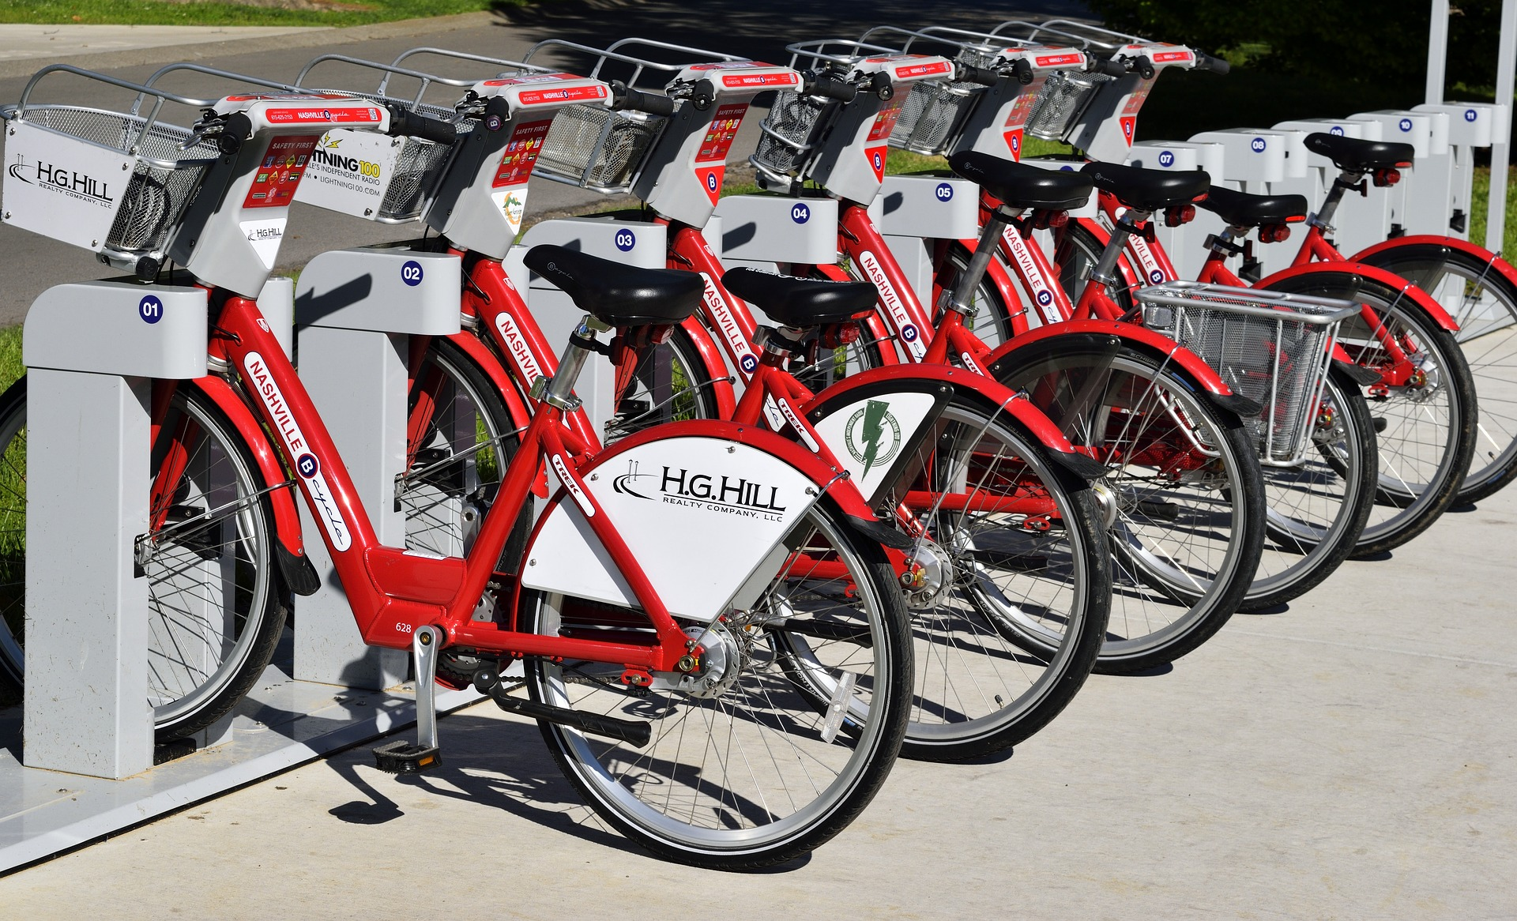
PROJECT #3: PREDICT BIKE RENTAL USAGE (REGRESSION)
The objective is to predict bike rental usage based on inputs such as temperature, humidity, wind speed..etc.
This problem is much more advanced compared to previous projects so we have to build a multi-layer perceptron network.
Image Source: https://pixabay.com/photos/bike-rental-bikes-rent-pay-2284380/
TensorFlow 2.0 PRACTICAL

Slide 4
PROJECT #3: PREDICT BIKE RENTAL USAGE (REGRESSION)
Inputs:
instant: record index
dteday: date
season: season (1: springer, 2: summer, 3: fall, 4: winter)
yr: year (0: 2011, 1: 2012)
mnth: month ( 1 to 12)
hr: hour (0 to 23)
holiday: whether day is holiday or not - weekday : day of the week
Working day: if day is neither weekend nor holiday is 1, otherwise is 0.
Image Source: https://pixabay.com/photos/bike-rental-bikes-rent-pay-2284380/
TensorFlow 2.0 PRACTICAL

Slide 5
PROJECT #3: PREDICT BIKE RENTAL USAGE (REGRESSION)
Inputs (continued):
weathersit :
1: Clear, Few clouds, Partly cloudy
2: Mist + Cloudy, Mist + Broken clouds, Mist + Few clouds, Mist
3: Light Snow, Light Rain + Thunderstorm + Scattered clouds, Light Rain + Scattered clouds
4: Heavy Rain + Ice Pallets + Thunderstorm + Mist, Snow + Fog
temp : Normalized temperature in Celsius. The values are divided to 41 (max)
Image Source: https://pixabay.com/photos/bike-rental-bikes-rent-pay-2284380/
TensorFlow 2.0 PRACTICAL

Slide 6
PROJECT #3: PREDICT BIKE RENTAL USAGE (REGRESSION)
Inputs (continued):
windspeed: Normalized wind speed. The values are divided to 67 (max)
Outputs:
casual: count of casual users
registered: count of registered users
cnt: count of total rental bikes including both casual and registered
Image Source: https://pixabay.com/photos/bike-rental-bikes-rent-pay-2284380/
TensorFlow 2.0 PRACTICAL

Slide 7
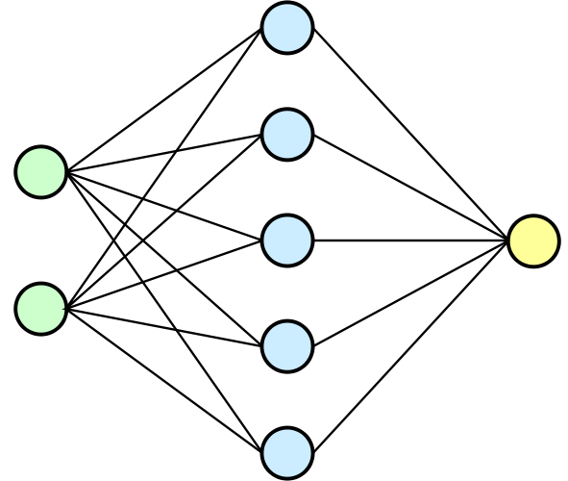
PROJECT #3: PREDICT BIKE RENTAL USAGE (REGRESSION)
TEMPERATURE
TRAINED ARTIFICIAL NEURAL NETWORK MODEL
WEATHER
WINDSPEED
SEASON
BIKE USAGE COUNT (TOTAL)
MONTH
Photo Credit: https://pixabay.com/vectors/thermometer-temperature-fever-309120/
Photo Credit: https://commons.wikimedia.org/wiki/File:Neural_network.svg
TensorFlow 2.0 PRACTICAL

Slide 8
WHAT IS REGRESSION?

Slide 9
PROJECT #3: WHAT IS REGRESSION?
Regression works by predicting value of one variable Y based on another variable X.
X is called the independent variable and Y is called the dependant variable.
BIKE RENTAL USAGE (COUNT)
TEMPERATURE (degC)
TensorFlow 2.0 PRACTICAL

Slide 10
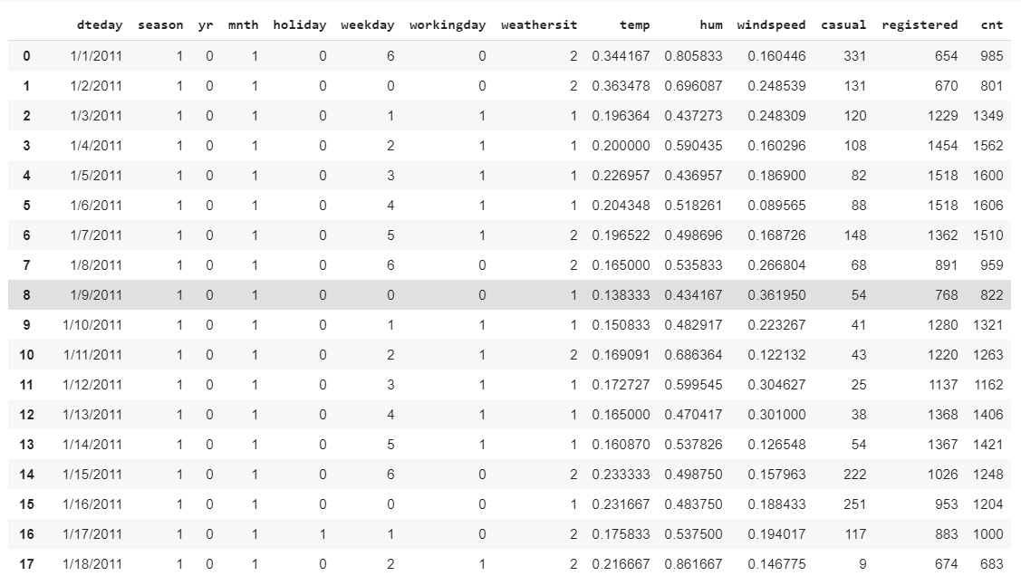
PROJECT #3: WHAT IS REGRESSION?
BIKE RENTAL USAGE (COUNT)
TEMPERATURE (degC)
TensorFlow 2.0 PRACTICAL

Slide 11

PROJECT #3: REGRESSION MATHEMATICS
Goal is to obtain a relationship (model) between the temperature and bike rental usage.
MODEL! (GOAL)
$$y=b+m∗x$$
200
BIKE RETNAL USAGE (COUNT)
DEPENDANT VARIABLE
BIKE RENTAL USAGE
INDEPENDENT VARIABLE
TEMPERATURE (C)
+10 degC
TEMPERATURE
TensorFlow 2.0 PRACTICAL

Slide 12
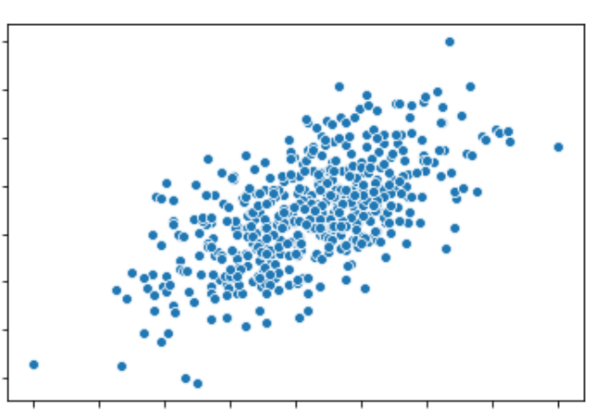

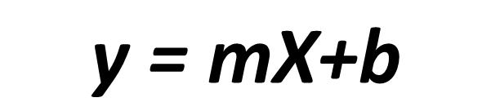



PROJECT #3: HOW ARE WE GOING TO USE THE MODEL?
$$\text{y}\text{ = }\text{mX}\text{+}\text{b}$$
Once the coefficients ‘m’ and ‘b’ are obtained, you have obtained a regression model!
This “trained” model can be later used to predict car purchase amount (dollars) based on the annual salary.
DEPENDANT
VARIABLE
INDEPENDANT
VARIABLE
$$Y$$
BIKE RETNAL USAGE (COUNT)
$$m$$
$$b$$
TEMPERATURE
$$X$$
TensorFlow 2.0 PRACTICAL

Slide 13






PROJECT #3: REGRESSION QUIZ!
$$y=3∗x$$
Match the equations to the figures:
$$y=15−10∗x$$
$$y$$
$$y$$
$$x$$
$$x$$
TensorFlow 2.0 PRACTICAL

Slide 14

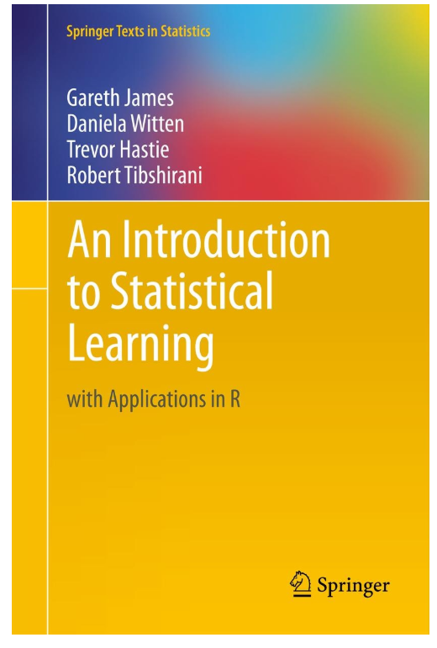
PROJECT #3: ADDITIONAL READING MATERIAL
Additional Resources, Page #123: http://www.cs.huji.ac.il/~shais/UnderstandingMachineLearning/understanding-machine-learning-theory-algorithms.pdf
Additional Resources, Page #61:
http://www-bcf.usc.edu/~gareth/ISL/ISLR%20Seventh%20Printing.pdf
TensorFlow 2.0 PRACTICAL

Slide 15
ARTIFICIAL NEURAL NETWORKS IN ACTION!

Slide 16
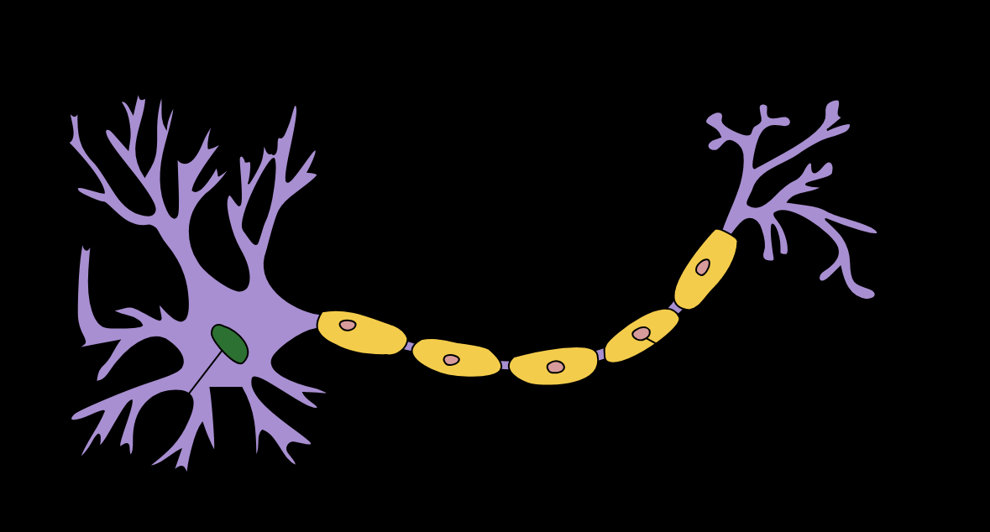


PROJECT #3: DO YOU REMEMBER OUR FIRST NEURON MODEL?
BIAS
THAT MODEL WAS TOO SIMPLE!
No activation function
One input
DENDRITES
INPUT
NEURON
$$W_{1}$$
$$OUTPUT$$
$$Output=Input ∗W_{1}+Bias$$
AXON
NUCLEAS
TensorFlow 2.0 PRACTICAL

Slide 17
PROJECT #3: NEURON MATHEMATICAL MODEL
The neuron collects signals from input channels named dendrites, processes information in its nucleus, and then generates an output in a long thin branch called axon.
X1
W1
NEURON
X2
W2
W3
DENDRITES
X3
AXON
NUCLEAS
TensorFlow 2.0 PRACTICAL

Slide 18








PROJECT #3: DO YOU REMEMBER OUR FIRST NEURON MODEL?
Bias allows to shift the activation function curve up or down.
Number of adjustable parameters = 4 (3 weights and 1 bias).
Activation function “F”.
b
$$X_{1}$$
$$W_{1}$$
F
$$W_{2}$$
INPUTS/INDEPENDENT VARIABLES
$$X_{2}$$
$$W_{3}$$
$$X_{3}$$
$$y=f(X_{1}W_{1}+X_{2}W_{2}+X_{3}W_{3}+b)$$
TensorFlow 2.0 PRACTICAL

Slide 19
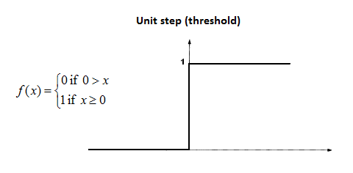










PROJECT #3: SINGLE NEURON MODEL IN ACTION!
Let’s assume an activation function of Unit Step.
The activation functions is used to map the input between (0, 1).
$$b=0$$
Input #1=1
$$X_{1}$$
$W_{1}$=0.7
F
$$X_{2}$$
$$W_{2}=0.1$$
Input #2=3
$$W_{3}=0.3$$
$$y=f\left(X_{1}W_{1}+X_{2}W_{2}+X_{3}W_{3}+b\right)$$
Input #3=4
$$X_{3}$$
$$y=f\left(1∗0.7+3∗0.1+4∗0.3\right)=f(2.2)$$
$$y=1 (because 2.2>0)$$
TensorFlow 2.0 PRACTICAL

Slide 20
ACTIVATION FUNCTIONS

Slide 21
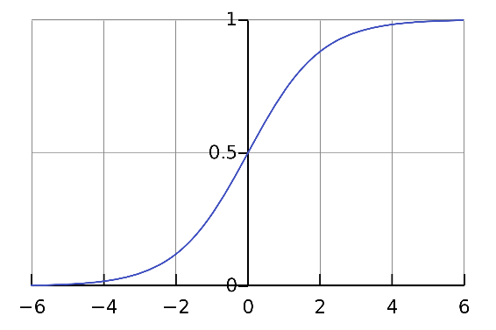
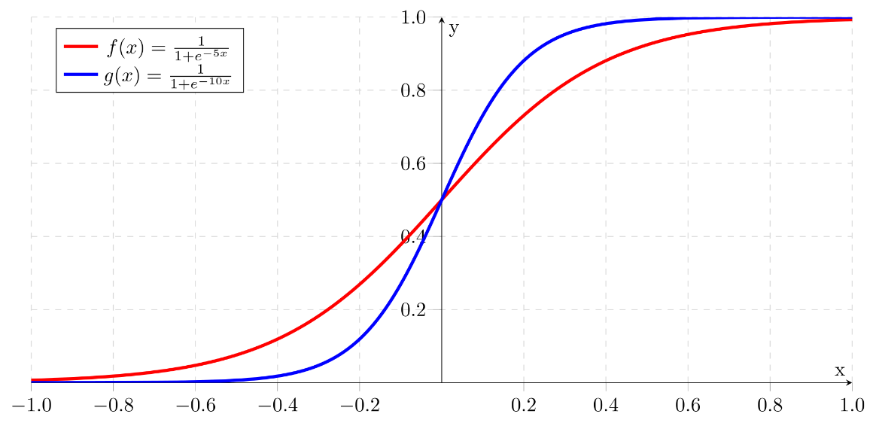
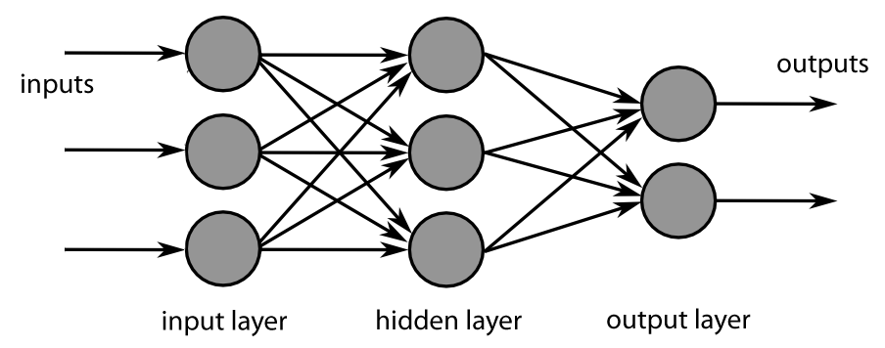
PROJECT #3: ACTIVATION FUNCTIONS
SIGMOID:
Takes a number and sets it between 0 and 1
Converts large negative numbers to 0 and large positive numbers to 1.
Generally used in output layer.
Photo credit: https://commons.wikimedia.org/wiki/File:Sigmoid-function.svg
Photo Credit: https://fr.m.wikipedia.org/wiki/Fichier:MultiLayerNeuralNetworkBigger_english.png
Photo Credit: https://commons.wikimedia.org/wiki/File:Logistic-curve.svg
TensorFlow 2.0 PRACTICAL

Slide 22
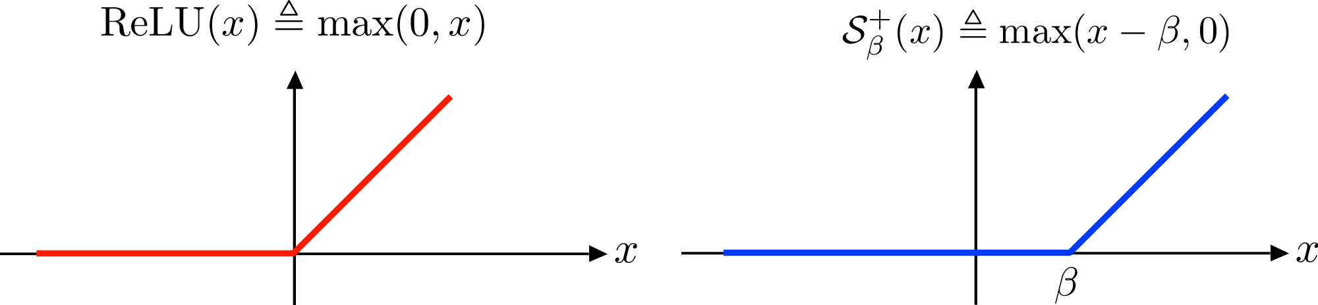
PROJECT #3: ACTIVATION FUNCTIONS
RELU (RECTIFIED LINEAR UNITS):
if input x < 0, output is 0 and if x > 0 the output is x.
RELU does not saturate so it avoids vanishing gradient problem.
It uses simple thresholding so it is computationally efficient.
Generally used in hidden layers.
TensorFlow 2.0 PRACTICAL
Photo credit: https://commons.wikimedia.org/wiki/File:ReLU_and_Nonnegative_Soft_Thresholding_Functions.svg
Photo Credit: https://fr.m.wikipedia.org/wiki/Fichier:MultiLayerNeuralNetworkBigger_english.png

Slide 23
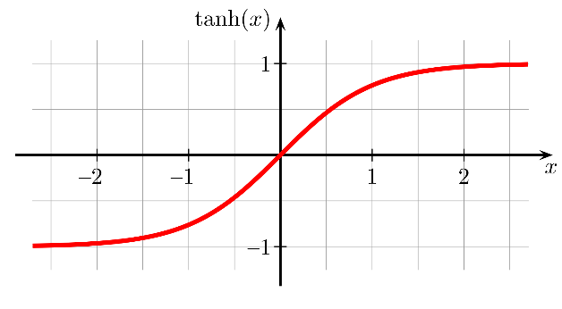
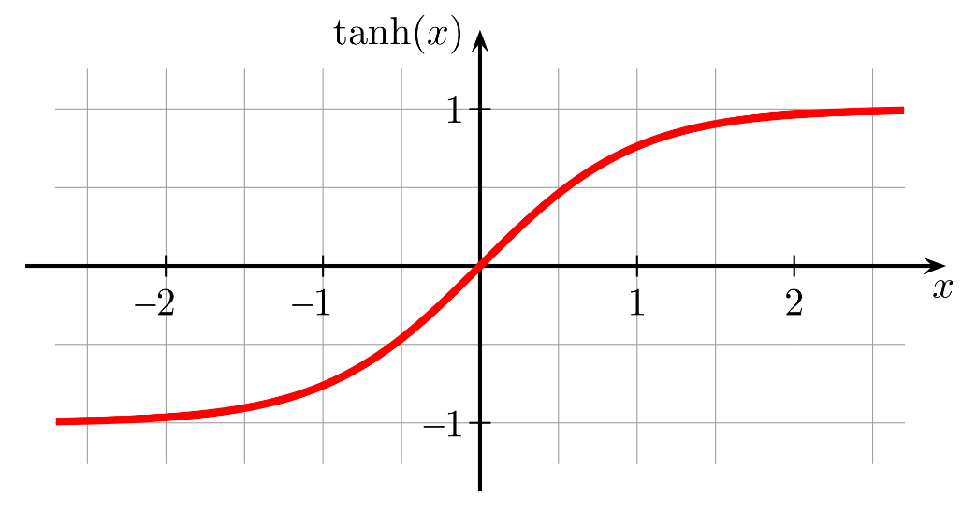
PROJECT #3: ACTIVATION FUNCTIONS
HYPERBOLIC TANGENT ACTIVATION FUNCTION:
“Tanh” is similar to sigmoid, converts number between -1 and 1.
Unlike sigmoid, tanh outputs are zero-centered (range: -1 and 1).
Tanh suffers from vanishing gradient problem so it kills gradients when saturated.
In practice, tanh is preferable over sigmoid.
TensorFlow 2.0 PRACTICAL
Photo credit: https://commons.wikimedia.org/wiki/File:Hyperbolic_Tangent.svg
Photo Credit: https://fr.m.wikipedia.org/wiki/Fichier:MultiLayerNeuralNetworkBigger_english.png

Slide 24
MULTI-NEURON MODEL (MULTI-LAYER PERCEPTRON MODEL)

Slide 25
PROJECT #3: MULTI-LAYER PERCEPTRON NETWORK
The network is represented by a matrix of weights, inputs and outputs.
Total Number of adjustable parameters = 8:
Weights = 6
Biases = 2
P1
W1
W2
n1
a1
Matrix Representation
P2
∑
f
W3
P3
b1
P1
W1
W2
n2
a2
P2
∑
f
W3
P3
b2
TensorFlow 2.0 PRACTICAL

Slide 26
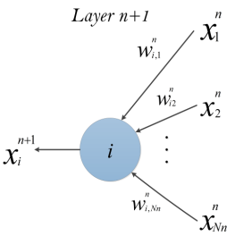
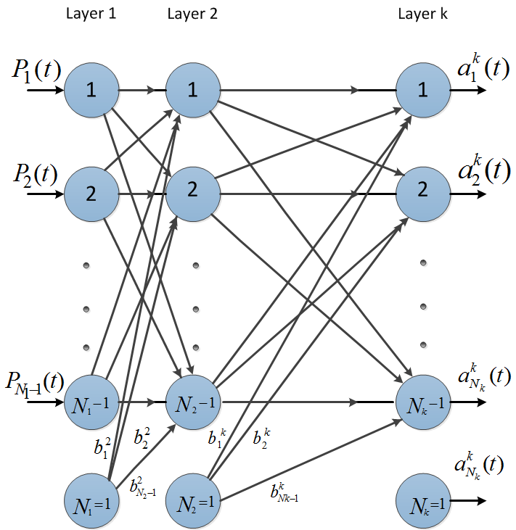



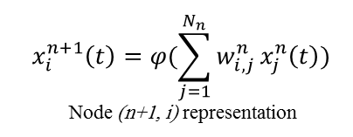
PROJECT #3: MULTI-LAYER PERCEPTRON NETWORK
Let’s connect multiple of these neurons in a multi-layer fashion.
The more hidden layers, the more “deep” the network will get.
$$x_{i}^{n+1}\left(t\right)=φ(\sum_{j=1}^{N_{n}}{w_{i, j}^{n}}x_{j}^{n}\left(t\right))$$
Node (n+1, i) representation
$$\left[\begin{matrix}\begin{matrix}W_{11} & W_{12} \\ W_{21} & W_{22}\end{matrix} & ⋯ & \begin{matrix}W_{1{, N}_{1}} \\ W_{2{, N}_{1}}\end{matrix} \\ ⋮ & ⋱ & ⋮ \\ \begin{matrix}W_{m−1,1} & W_{m−1,2} \\ W_{m,1} & W_{m,2}\end{matrix} & ⋯ & \begin{matrix}W_{m−1{, N}_{1}} \\ W_{m{, N}_{1}}\end{matrix}\end{matrix}\right]$$
Non-Linear Sigmoid Activation function
$$φ\left(w\right)=\frac{1}{1+e^{−w}}$$
m: number of neurons in the hidden layer
$N_{1}$: number of inputs
TensorFlow 2.0 PRACTICAL

Slide 27
HOW DO ANNS TRAIN?

Slide 28
PROJECT #3: ANN TRAINING STRATEGIES
Supervised learning
Used if there is large set of test data with known labels (outputs).
The learning algorithm evaluates output ( i.e.: makes predictions), compares output against the label, and adjust network and repeat.
Unsupervised learning
Used with "unlabeled" data (not categorized) (Ex: k-means clustering).
Since learning algorithm works with unlabeled data, there is no way to assess the accuracy of the structure suggested by the algorithm
Reinforced learning
Learning algorithm takes actions that maximizes some notion of cumulative reward.
Over time, the network learns to prefer the right kind of action and to avoid the wrong one.
TensorFlow 2.0 PRACTICAL

Slide 29


PROJECT #3: EPOCHS
Predicted
Output
$$\hat{Y}$$
Desired (True) Output Y
Testing
inputs
X
Training
inputs
X
Error = $\hat{Y}−Y$
$$C = ½{\left(\hat{Y}−Y\right)}^{2}$$
Update Network Weights
TensorFlow 2.0 PRACTICAL

Slide 30
PROJECT #3: DIVIDE DATA INTO TRAINING AND TESTING
Data set is generally divided into 50%, 25%, 25% segments for training, validation, and testing, respectively.
Training set: used for gradient calculation and weight update.
Validation set:
used for cross-validation which is performed to assess training quality as training proceeds.
Cross-validation is implemented to overcome over-fitting (over-training). Over-fitting occurs when algorithm focuses on training set details at cost of losing generalization ability.
Trained network MSE might be small during training but during testing, the network may exhibit poor generalization performance.
Testing set: used for testing trained network.
TensorFlow 2.0 PRACTICAL

Slide 31
TENSORFLOW PLAYGROUND

Slide 32
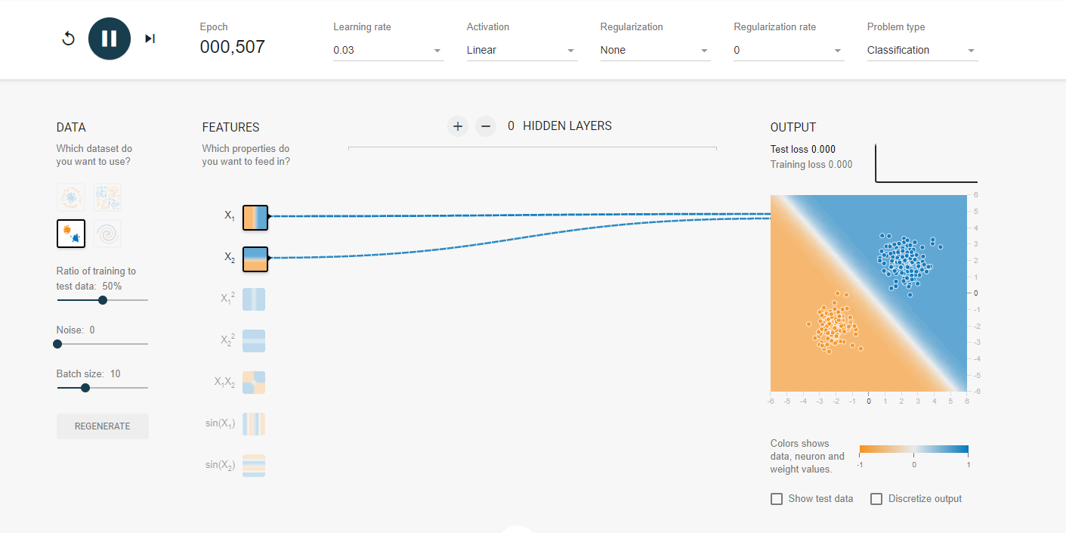
PROJECT #3: DEEP DIVE INTO TF PLAYGROUND
Check this out: https://playground.tensorflow.org
TensorFlow 2.0 PRACTICAL

Slide 33
GRADIENT DESCENT

Slide 34
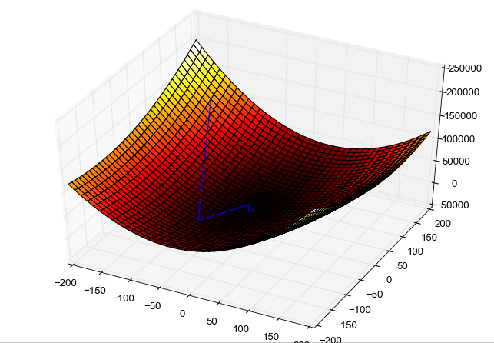
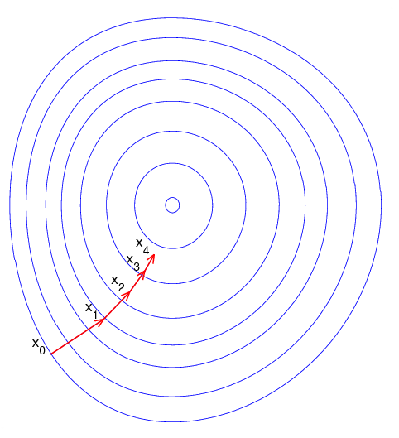
PROJECT #3: GRADIENT DESCENT
Gradient descent is an optimization algorithm used to obtain the optimized network weight and bias values
It works by iteratively trying to minimize the cost function
It works by calculating the gradient of the cost function and moving in the negative direction until the local/global minimum is achieved
If the positive of the gradient is taken, local/global maximum is achieved
Photo Credit: https://commons.wikimedia.org/wiki/File:Gradient_descent_method.png
Photo Credit: https://commons.wikimedia.org/wiki/File:Gradient_descent.png
TensorFlow 2.0 PRACTICAL

Slide 35
PROJECT #3: LEARNING RATE
The size of the steps taken are called the learning rate
If learning rate increases, the area covered in the search space will increase so we might reach global minimum faster
However, we can overshoot the target
For small learning rates, training will take much longer to reach optimized weight values
TensorFlow 2.0 PRACTICAL

Slide 36


PROJECT #3: GRADIENT DESCENT
Gradient descent works as follows:
Calculate the derivative (gradient) of the Loss function
Pick random values for parameters m, b and substitute
Calculate the step size (how much are we going to update the parameters?)
$Step size = Slope ∗ learning rate$
4. Update the parameters and repeat
OPTIMAL POINT
GLOBAL MINIMUM
Sum of Squared Residuals
$$y=b+m∗x$$
GOAL IS TO FIND
BEST PARAMETERS
*Note: in reality, this graph is 3D and has three axes, one for m, b and sum of squared residuals
Parameters (m, b)
TensorFlow 2.0 PRACTICAL

Slide 37

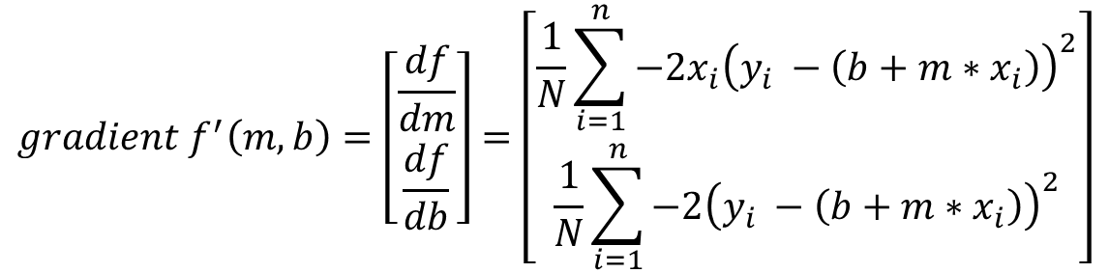
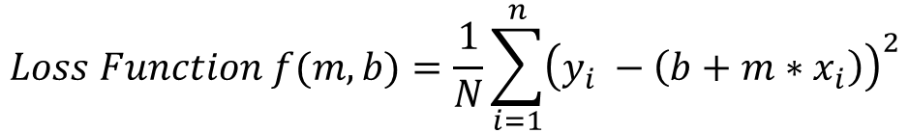
PROJECT #3: GRADIENT DESCENT MATH!
$$y=b+m∗x$$
GOAL IS TO FIND
BEST PARAMETERS
$$Loss Function f(m,b)=\frac{1}{N}\sum_{i=1}^{n}{{\left(y_{i} −\left(b+m∗x_{i}\right)\right)}^{2}}$$
OPTIMAL POINT
GLOBAL MINIMUM
$$gradient f^{′}\left(m,b\right)=\left[\begin{matrix}\frac{df}{dm} \\ \frac{df}{db}\end{matrix}\right]=\left[\begin{matrix}\frac{1}{N}\sum_{i=1}^{n}{−2x_{i}{\left(y_{i} −\left(b+m∗x_{i}\right)\right)}^{2}} \\ \frac{1}{N}\sum_{i=1}^{n}{−2{\left(y_{i} −\left(b+m∗x_{i}\right)\right)}^{2}}\end{matrix}\right]$$
Sum of Squared Residuals (Loss Function)
Parameters (m, b)
*Note: in reality, this graph is 3D and has three axes, one for m, b and sum of squared residuals
TensorFlow 2.0 PRACTICAL

Slide 38
BACKPROPAGATION

Slide 39
PROJECT #3: BACK PROPAGATION
Backpropagation is a method used to train ANNs by calculating gradient needed to update network weights.
It is commonly used by the gradient descent optimization algorithm to adjust the weight of neurons by calculating the gradient of the loss function.
STEP 1: FORWARD PROPAGATION
STEP 2: ERROR CALCULATION
STEP 4: WEIGHT UPDATE
STEP 3: BACK PROPAGATION
TensorFlow 2.0 PRACTICAL

Slide 40
PROJECT #3: BACK PROPAGATION
Backpropagation Phase 1: propagation
Propagation forward through the network to generate the output value(s)
Calculation of the cost (error term)
Propagation of output activations back through network using training pattern target in order to generate the deltas (difference between targeted and actual output values)
STEP 1: FORWARD PROPAGATION
STEP 2: ERROR CALCULATION
STEP 4: WEIGHT UPDATE
STEP 3: BACK PROPAGATION
TensorFlow 2.0 PRACTICAL

Slide 41
PROJECT #3: BACK PROPAGATION
Phase 2: weight update
Calculate weight gradient.
A ratio (percentage) of the weight's gradient is subtracted from the weight.
This ratio influences the speed and quality of learning and called learning rate. The greater the ratio, the faster neuron train, but lower ratio, more accurate the training is.
STEP 1: FORWARD PROPAGATION
STEP 2: ERROR CALCULATION
STEP 4: WEIGHT UPDATE
STEP 3: BACK PROPAGATION
TensorFlow 2.0 PRACTICAL

Slide 42
PROJECT #3: BACK PROPAGATION ADDITIONAL READING MATERIAL
“Backpropagation neural networks: A tutorial” by Barry J.Wythoff
“Improved backpropagation learning in neural networks with windowed momentum”, International Journal of Neural Systems, vol. 12, no.3&4, pp. 303-318.
TensorFlow 2.0 PRACTICAL

Slide 43
BIAS VARIANCE TRADE-OFF

Slide 44
PROJECT #3: BIAS VARIANCE INTUITION
Let’s assume that we want to get the relationship between the Temperature and Bike rental usage.
As temperature experience increase, the bike rental usage tend to increase as well.
As temperature goes beyond a certain limit, usage tend to plateau and it does not increase anymore.
PERFECT (TRUE) MODEL!
BIKE USAGE
TEMPERATURE
TensorFlow 2.0 PRACTICAL
Image Source: https://pixabay.com/photos/bike-rental-bikes-rent-pay-2284380/

Slide 45
PROJECT #3: BIAS VARIANCE TRAINING VS. TESTING DATASETS
Dataset is divided to training and testing datasets
Testing datasets have never been seen by the model before
BIKE RENTAL USAGE
TESTING DATASET
TRAINING DATASET
TEMPERATURE
TensorFlow 2.0 PRACTICAL

Slide 46
PROJECT #3: BIAS AND VARIANCE: TRAINING VS. TESTING DATASETS
Dataset is divided to training and testing datasets
Testing datasets have never been seen by the model before
BIKE RENTAL USAGE
TESTING DATASET
TRAINING DATASET
TEMPERATURE

Slide 47
PROJECT #3: BIAS AND VARIANCE: MODEL #1– LINEAR REGRESSION (SIMPLE)
Linear Regression model uses a straight line to fit the training dataset
Linear regression model lacks flexibility so it cannot properly fit the data (as the true perfect model does!)
The linear model has a large “bias” which indicates that the model is unable to accurately capture the true relationship between temperature and rental usage.
PERFECT (TRUE) MODEL!
BIKE RENTAL USAGE
LINEAR REGRESSION MODEL
TRAINING DATASET
TEMPERATURE

Slide 48
PROJECT #3: BIAS AND VARIANCE: MODEL #2 – HIGH ORDER POLYNOMIAL REGRESSION (COMPLEX)
PERFECT (TRUE) MODEL!
High order polynomial model is able to have a very small bias and can perfectly fit the training dataset.
High-order polynomial model is very flexible
BIKE RENTAL USAGE
HIGH ORDER POLYNOMIAL MODEL
TRAINING DATASET
TEMPERATURE

Slide 49


PROJECT #3: BIAS AND VARIANCE: MODEL #1 Vs. MODEL #2 DURING TRAINING
PERFECT (TRUE) MODEL!
PERFECT (TRUE) MODEL!
RENTAL USAGE
RENTAL USAGE
LINEAR REGRESSION MODEL
HIGH ORDER POLYNOMIAL MODEL
TEMPERATURE
TEMPERATURE
SUM OF SQUARES (LARGE)
SUM OF SQUARES (SMALL ~0)
THIS IS NOT THE WHOLE STORY!!

Slide 50
PROJECT #3: BIAS AND VARIANCE: MODEL #1 Vs. MODEL #2 DURING TESTING
PERFECT (TRUE) MODEL!
PERFECT (TRUE) MODEL!
RENTAL USAGE
RENTAL USAGE
LINEAR REGRESSION MODEL
HIGH ORDER POLYNOMIAL MODEL
TEMPERATURE
TEMPERATURE
SUM OF SQUARES (SMALL)
SUM OF SQUARES (LARGE)
The polynomial model performs poorly on the testing dataset and therefore it has large variance

Slide 51
PROJECT #3: MODEL COMPLEXITY VS. ERROR
OPTIMUM MODEL
Regularization works by reducing the variance at the cost of adding some bias to the model.
A trade-off between variance and bias occurs
TOTAL ERROR
VARIANCE
ERROR
BIAS
MODEL COMPLEXITY
LINEAR
POLYNOMIAL

Slide 52
PROJECT #3: MODEL COMPLEXITY VS. ERROR
MODEL #1 (LINEAR REGRESSION) (SIMPLE) | MODEL #2 (HIGH ORDER POLYNOMIAL) (COMPLEX)
Model has High bias because it is very rigid (not flexible) and cannot fit the training dataset well | Model has small bias because it is flexible and can fit the training dataset very well.
Has small variance (variability) because it can fit the training data and the testing data with similar level (the model is able to generalize better) and avoids overfitting | Has large variance (variability) because the model over fitted the training dataset and it performs poorly on the testing dataset
Performance is consistent between the training dataset and the testing dataset | Performance varies greatly between the training dataset and the testing dataset (high variability)
Good generalization | Over fitted
Variance measures the difference in fits between the training dataset and the testing dataset
If the model generalizes better, the model has small variance which means the model performance is consistent among the training and testing datasets
If the model over fits the training dataset, the model has large variance
PERFECT REGRESSION MODEL SHALL HAVE SMALL BIAS AND SMALL VARIABILITY!
A TRADEOFF BETWEEN THE BIAS AND VARIANCE SHALL BE PERFORMED FOR ULTIMATE RESULTS

Slide 53
MODEL PERFORMANCE ASSESSMENT – METRICS

Slide 54
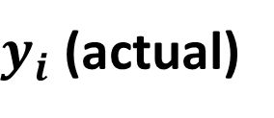
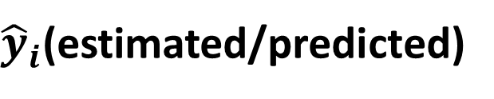
PROJECT #3: REGRESSION METRICS: HOW TO ASSESS MODEL PERFORMANCE?
After model fitting, we would like to assess the performance of the model by comparing model predictions to actual (True) data
$y_{i}$ (actual)
$$Error$$
$$Residuals (Error)={\hat{y}}_{i}−y_{i}$$
BIKE RENTAL USAGE
${\hat{y}}_{i}$(estimated/predicted)
TEMPERATURE (DegC)
Image Source: https://pixabay.com/photos/bike-rental-bikes-rent-pay-2284380/
Source: https://www.goodfreephotos.com/vector-images/ice-cream-stand-vector-clipart.png.php

Slide 55
PROJECT #3: REGRESSION METRICS: MEAN ABSOLUTE ERROR (MAE)
Mean Absolute Error (MAE) is obtained by calculating the absolute difference between the model predictions and the true (actual) values
MAE is a measure of the average magnitude of error generated by the regression model
The mean absolute error (MAE) is calculated as follows:
$$MAE=\frac{1}{n}\sum_{i=1}^{n}{|y_{i}−{\hat{y}}_{i}|}$$
MAE is calculated by following these steps:
Calculate the residual of every data point
Calculate the absolute value (to get rid of the sign)
Calculate the average of all residuals
If MAE is zero, this indicates that the model predictions are perfect.

Slide 56
PROJECT #3: REGRESSION METRICS: MEAN SQUARE ERROR (MSE)
Mean Square Error (MSE) is very similar to the Mean Absolute Error (MAE) but instead of using absolute values, squares of the difference between the model predictions and the training dataset (true values) is being calculated.
MSE values are generally larger compared to the MAE since the residuals are being squared.
In case of data outliers, MSE will become much larger compared to MAE
In MSE, error increases in a quadratic fashion while the error increases in proportional fashion in MAE
In MSE, since the error is being squared, any predicting error is being heavily penalized
The MSE is calculated as follows:
$$MSE=\frac{1}{n}\sum_{i=1}^{n}{{\left(y_{i}−{\hat{y}}_{i}\right)}^{2}}$$
MSE is calculated by following these steps:
Calculate the residual for every data point
Calculate the squared value of the residuals
Calculate the average of results from step #2

Slide 57

PROJECT #3: REGRESSION METRICS: ROOT MEAN SQUARE ERROR (RMSE)
Root Mean Square Error (RMSE) represents the standard deviation of the residuals (i.e.: differences between the model predictions and the true values (training data)).
RMSE can be easily interpreted compared to MSE because RMSE units match the units of the output.
RMSE provides an estimate of how large the residuals are being dispersed.
The RMSE is calculated as follows:
$$RMSE=\sqrt{\frac{1}{n}\sum_{i=1}^{n}{{\left(y_{i}−{\hat{y}}_{i}\right)}^{2}}}$$
RMSE is calculated by following these steps:
Calculate the residual for every data point
Calculate the squared value of the residuals
Calculate the average of the squared residuals
Obtain the square root of the result

Slide 58
PROJECT #3: REGRESSION METRICS: MEAN ABSOLUTE PERCENTAGE ERROR (MAPE)
MAE values can range from 0 to infinity which makes it difficult to interpret the result as compared to the training data.
Mean Absolute Percentage Error (MAPE) is the equivalent to MAE but provides the error in a percentage form and therefore overcomes MAE limitations.
MAPE might exhibit some limitations if the data point value is zero (since there is division operation involved)
The MAPE is calculated as follows:
$$MAPE=\frac{100\%}{n}\sum_{i=1}^{n}{|(y_{i}−{\hat{y}}_{i})/y_{i}|}$$

Slide 59
PROJECT #3: REGRESSION METRICS: MEAN PERCENTAGE ERROR (MPE)
MPE is similar to MAPE but without the absolute operation
MPE is useful to provide an insight of how many positive errors as compared to negative ones
The MPE is calculated as follows:
$$MPE=\frac{100\%}{n}\sum_{i=1}^{n}{(y_{i}−{\hat{y}}_{i})/y_{i}}$$

Slide 60

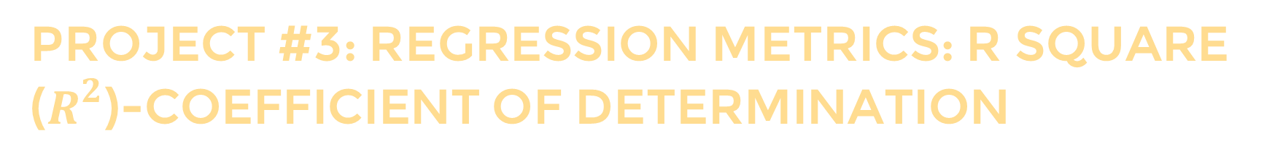
PROJECT #3: REGRESSION METRICS: R SQUARE ($R^{2}$)-COEFFICIENT OF DETERMINATION
R-square or the coefficient of determination represents the proportion of variance (of y) that has been explained by the independent variables in the model.
If $R^{2}=80$, this means that 80% of the increase in bike rental usage is due to increase in temperature.
BIKE RENTAL LUSAGE
TEMPERATURE (DegC)
Image Source: https://pixabay.com/photos/bike-rental-bikes-rent-pay-2284380/

Slide 61

PROJECT #3: REGRESSION METRICS: R SQUARE ($R^{2}$)-COEFFICIENT OF DETERMINATION
R-square or the coefficient of determination represents the proportion of variance ($y$) that has been explained by the independent variables ($X$) in the model.
It provides an indication of goodness of fit and therefore a measure of how well unseen samples are likely to be predicted by the model, through the proportion of explained variance.
Best possible score is 1.0
A constant model that always predicts the expected value of y, disregarding the input features, would get a R² score of 0.0.
$$R^{2}=1−\frac{\sum_{i=1}^{n}{{\left(y_{i}−{\hat{y}}_{i}\right)}^{2}}}{\sum_{i=1}^{n}{{\left(y_{i}−\overline{y}\right)}^{2}}}$$

Slide 62
PROJECT #3: REGRESSION METRICS: R SQUARE ($R^{2}$)-COEFFICIENT OF DETERMINATION
R-square represents the proportion of variance of the dependant variable (y) that has been explained by the independent variables.
R-square provides an insight of goodness of fit.
It gives a measure of how well unseen samples are likely to be predicted by the model, through the proportion of explained variance.
Maximum $R^{2}$ value is 1
A constant model that always predicts the expected value of y, disregarding the input features, will have an R² score of 0.0.
$$R^{2}=1−\frac{\sum_{i=1}^{n}{{\left(y_{i}−{\hat{y}}_{i}\right)}^{2}}}{\sum_{i=1}^{n}{{\left(y_{i}−\overline{y}\right)}^{2}}}$$

Slide 63


PROJECT #3: REGRESSION METRICS: ADJUSTED R SQUARE ($R^{2}$)
If $R^{2}=80$, this means that 80% of the increase in bike rental usage is due to increase in temperature.
Let’s add another ‘useless’ independent variable, let’s say color of the bike to the Z-axis.
Now $R^{2}$ increases and becomes: $R^{2}=85\%$
BIKE RENTAL USAGE
COLOR OF BIKE
TEMPERATURE (DegC)
Image Source: https://pixabay.com/photos/bike-rental-bikes-rent-pay-2284380/

Slide 64


PROJECT #3: REGRESSION METRICS: ADJUSTED R SQUARE ($R^{2}$)
One limitation of $R^{2}$ is that it increases by adding independent variables to the model which is misleading since some added variables might be useless with minimal significance.
Adjusted $R^{2}$ overcomes this issue by adding a penalty if we make an attempt to add independent variable that does not improve the model.
Adjusted $R^{2}$ is a modified version of the $R^{2}$ and takes into account the number of predictors in the model.
If useless predictors are added to the model, Adjusted $R^{2}$ will decrease
If useful predictors are added to the model, Adjusted $R^{2}$ will increase
$K$ is the number of independent variables and $n$ is the number of samples
$$R_{adjusted}^{2}=1−[\frac{\left(1−R^{2}\right)\left(n−1\right)}{n−k−1}]$$

